Slide 1
INDUSTRY SPECIFIC INTELLIGENCE FIRE MANAGEMENT SYSTEM
TEAM MENTOR:
Pavithra M M.E(Ph.D)
Assistant processor/CSE
TEAM ID: PNT2022TMID42571
Danaendraraj R -711119104019
Boomeswaran V -711119104017
Chilakam Bindu Reddy -711119104018
Gayam Naveena -711119104023

Slide 2
INTRODUCTION:
IOT devices are hardware devices, such as sensors, gadgets, appliances and other machines that collect and exchange data over the Internet.
Sending random fire and temperature values will be sent to the IBM IOT platform
Sensors values can be viewed in the Web Application
Notifies the admin the random values cross the threshold value

Slide 3
INTRODUCTION (Cont...)
To accomplish this, we have to complete all the activities and tasks listed below:
Create and configure IBM Cloud Services
Develop a web Application using Node-RED Service
Create and implement an alert System Service using BULK Services

Slide 4
ABSTRACT:
It includes temperature sensor,gas sensor ,flame sensor. If the temperature increased limit automatically the exhaust will switch on.
If suppose the flame is detected automatically the sprinklers will be switched on. If the harmful gases detected automatically the alarm will be switched on.
Emergency alerts are noticed to the nearest fire stations and authorities.

Slide 5
EXISTING PROBLEM:
The fire alarm monitoring system of fire protection engineering has formed a complete system, including alarm monitoring, automatic fire control, fire linkage control, and fire data monitoring and analysis modules. The benefits of this fire detection system can detect early fire occurrence based on the detection of temperature conditions by accommodating the nature of the fire and able to detect any rise in temperature caused by the existence of the fire, the fire alarm will be turned on

Slide 6
PROPOSED SOLUTION: Problem Statement (Problem to be solved)- To improve fire management and alert system in Industries. Providing a safe environment for the workers. Idea/Solution description-To provide fire management and alert system in industry based on IOT with fire detection. Novelty/Uniqueness-An fire system integrated with temperature sensor ,gas sensor,flame sensor,exhaust fan ,water sprinklers and and fire alert throught SMS. Social Impact / Customer Satisfaction-It reduces the damages caused by fire accidents in Industries. Business Model (Revenue model)-This system can be used as a safety system in industries Scalability of the Solution-This project trying to execute the method with an help of an IOT gadget, which provide a safe environment for workers in industries.

Slide 7
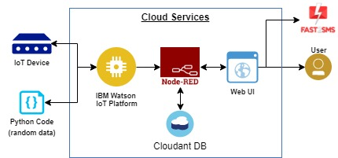
SOLUTION ARCHITECTURE:

Slide 8
WORKING:
1. The user should provide information to get registered in the web application and this user
database will be stored in IBM cloudant through node-red.
2. Here we use IOT’s such as temperature sensor, gas sensor, flame sensor.
3. Temperature sensor senses the temperature, flame sensor senses if there is any flame and
the gas sensor senses the gases present in the environment.

Slide 9
WORKING (CONT..)
4. The Web UI-Node Red will display the sensed values in the dashboard. Whereas IOT
Board process the data from the sensors, if any changes detected in the environment then it
will turn on the water sprinklers and fire alarm.
5. It will also send an emergency alert to IBM cloudant so that the registered user will receive
a SMS and nearby fire station will be notified

Slide 10
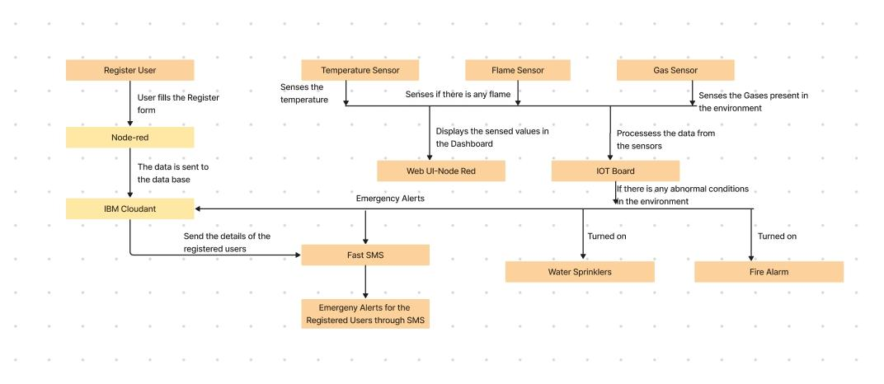
DATA FLOW DIAGRAM:

Slide 11
FEATURES:
IBM Watson Interfacing with Node-RED
Send Alert using SMS
API SMS through Bulk SMS Service via Fast2sms

Slide 12
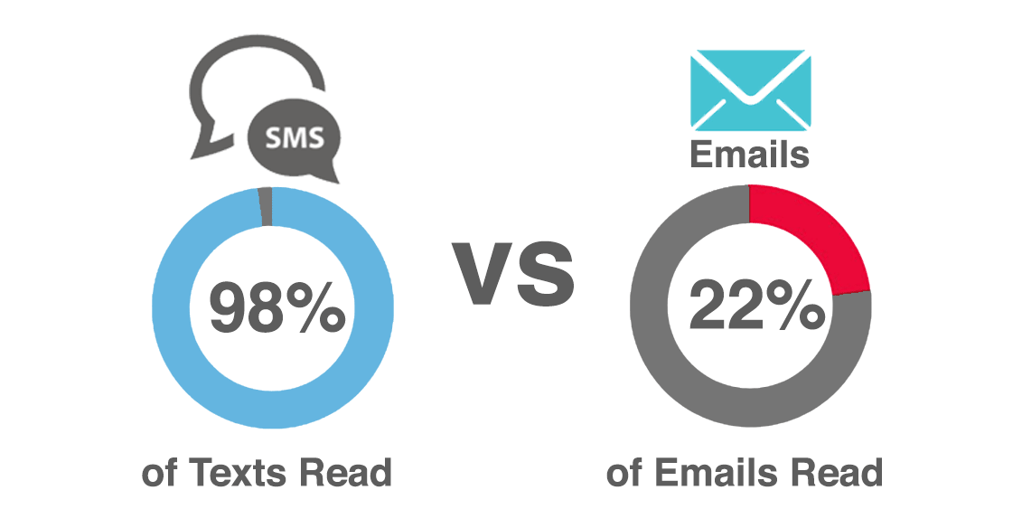
Why do we choose to send alert through SMS?

Slide 13
ADVANTAGES:
Easy to install and maintain
Protecting multiple hazards with just one system
Scalable to any size of protecting areas
Capital damage can be avoided
Many lives can be saved

Slide 14
DISADVANTAGES:
Requires stable internet connection
Need a Experienced technician
Any malfunction of system could cause unwanted nuisance
Unreliable water supply

Slide 15
CONCLUSION:
Thus this Fire management system play a very important role in Industries, Shops, Malls,
Residential complexes, and parking areas. They help in detecting fire or harmful gas at an
early stage and can help in saving lives. Commercial Fire detecting systems usually have an
alarm signaling, with the help of a buzzer or Siren. We have designed an this system to send
an immediate alert through the bulk sms service via fast2sms. These systems do not require
any human interaction. In this Industrial fire management system using temperature, flame
and gas sensors using the IOT project, we can send LIVE information like Temperature, gas
and flame detected by a particular device to the Fire Department so the capital damage can be
avoided.

Slide 16
CODE:
def Alert():
url = "https://www.fast2sms.com/dev/bulkV2"
my_data = {
'sender_id': 'FSTSMS',
'message': 'Alert Fire has been detected in XYZ industry! Kindly Evacuvate from the place',
'language': 'english',
'route': 'p',
'numbers': '9095057479,9347534114,8610804600,8328540919'
}
headers = {
'authorization': 'o0azwVFNHOM5B3hrRxdenyU2cfZujqSpYEX7t8LAgJPb9kliWCugDvo1n0kcY8TGHOt3dIQwsKpLbAJU',
'Content-Type': "application/x-www-form-urlencoded",
'Cache-Control': "no-cache"
}
import time
import sys
import ibmiotf.application
import ibmiotf.device
import random
import ibmiotf.api
import requests
import json
#Provide your IBM Watson Device Credentials
organization = "lryrya"
deviceType = "Temp"
deviceId = "T1"
authMethod = "token"
authToken = "123456789"
temp=0
alert=0

Slide 17
response = requests.request("POST",
url,
data = my_data,
headers = headers)
returned_msg = json.loads(response.text)
print(returned_msg['message'])
def myCommandCallback(cmd):
print("Command received: %s" % cmd.data['command'])
status=cmd.data['command']
if status=="lighton":
print ("led is on")
else :
print ("led is off")
try:
deviceOptions = {"org": organization, "type": deviceType, "id": deviceId, "auth-method": authMethod, "auth-token": authToken}
deviceCli = ibmiotf.device.Client(deviceOptions)
except Exception as e:
print("Caught exception connecting device: %s" % str(e))
sys.exit()
deviceCli.connect()
while True:
if temp<100:
#Get Sensor Data from DHT11
temp=temp+1
data = { 'Temperature' : temp}
#print data
def myOnPublishCallback():
print ("Published Temperature = %s C" %temp, "to IBM Watson")
if(temp>70) and (alert==0):
Alert();
time.sleep(1)
alert=alert+1
success = deviceCli.publishEvent("IoTSensor", "json", data, qos=0, on_publish=myOnPublishCallback)
else:
temp=0;
if not success:
print("Not connected to IoTF")
time.sleep(1)
deviceCli.disconnect()

Slide 18
REFERENCE:
Bagheri, M. (2007). Efficient K-Coverage Algorithms for Wireless Sensor Networks and
Their Applications to Early Detection of Forest Fires. Computing Science, SIMON FRASER
UNIVERSITY. MSc.
Bernardo, L., R. Oliveira, et al. (2007). A Fire Monitoring Application for Scattered Wireless
Sensor Networks: A peer-to-peer cross-layering approach International Conference on
Wireless Information Networks and Systems (WINSYS'07), Barcelona, Spain.
Zhiping, L., Q. Huibin, et al. (2006). The Design of Wireless Sensor Networks for Forest Fire
Monitoring System. School of Electronics and Information, Hangzhou Dianzi University,
White Paper.

Slide 19
Project Deliverables:
Git Repo Link:
https://github.com/IBM-EPBL/IBM-Project-20902-1659766144
Project Web Page:
https://ibmproject1234.000webhostapp.com/

Slide 20
THANK YOU

